Slide 1

Rajshahi University of Engineering & Technology Department of Mechatronics Engineering
Heaven’s light is our guide
Course Title: Seminar
Course No. : MTE 4210
Thesis Title :
Environment Condition Monitoring and Long Distance Actuator Control using Wireless Sensor Network (WSN)
Submitted By:
Asif Bin Karim (148004)
Saquib Shahriar (148007)
Supervised By:
Md. Manirul Islam
Assistant Professor, Department of Mechatronics Engineering,
Rajshahi University of Engineering & Technology.

Slide 2

Outlines
Motivation
Objectives
Introduction
Challenges
Literature Review
Components
System Architecture
Data Acquisition & Analysis
MQTT (Message Queuing Telemetry Transport) Server Design & Implementation
Discussion
Future Works
Environment Condition Monitoring and Long Distance Actuator Control using Wireless Sensor Network (WSN)
Date : 07.09.2019 MTE 4210 Page No. : 01

Slide 3
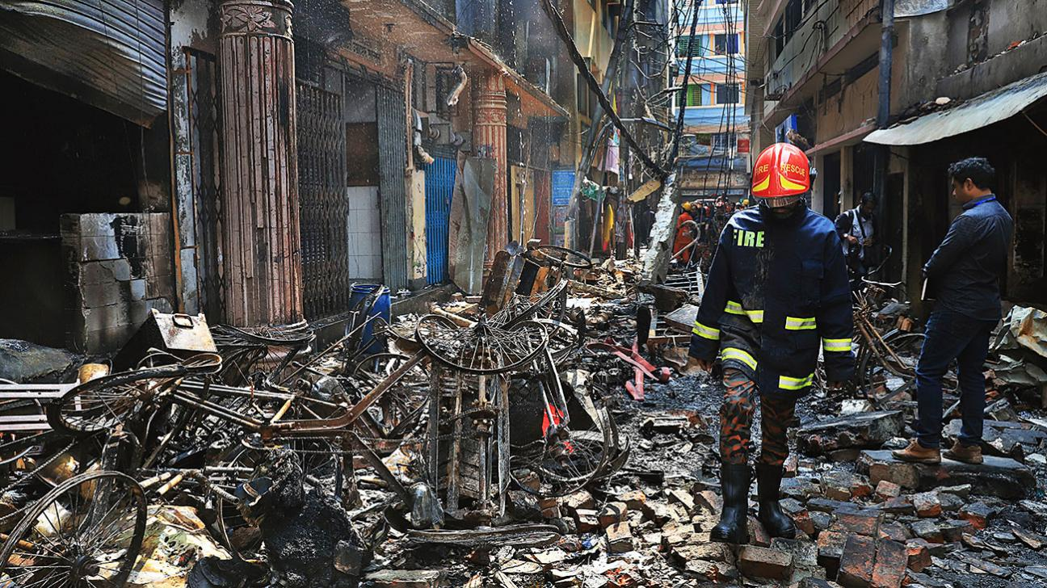
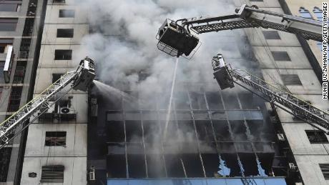
Motivation of this work
Environment monitoring system for chemical storages, industries, office and the overcrowded areas
Remotely operated fast prevention technique
Automatically operated and responsive prevention technique
Minimizing the loss of fire accidents
Environment Condition Monitoring and Long Distance Actuator Control using Wireless Sensor Network (WSN)
Date : 07.09.2019 MTE 4210 Page No. : 02

Slide 4
Objectives
To Construct a wireless sensor network with minimal coding space in controller
To monitor the condition of a control volume
To calibrate and analyze raw noisy sensor data
To select optimal statistical filter using MATLAB in a real time operation
To implement swift feedforward control mechanism for controlling actuators when needed
Environment Condition Monitoring and Long Distance Actuator Control using Wireless Sensor Network (WSN)
Date : 07.09.2019 MTE 4210 Page No. : 03

Slide 5
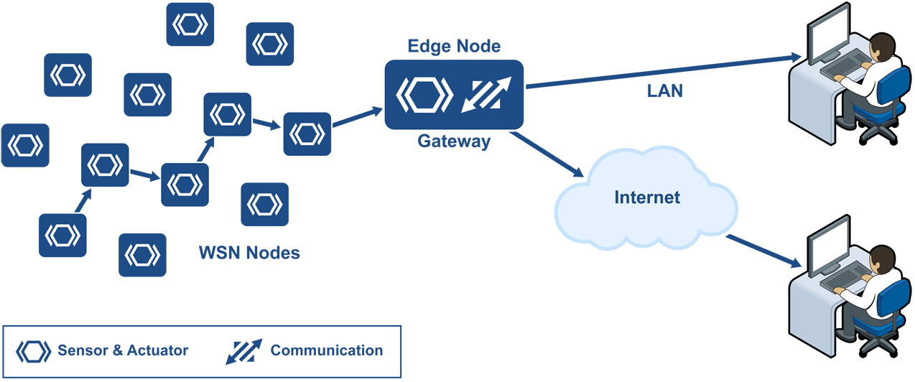
Introduction
A network of devices that can communicate the information gathered from a monitored field through wireless links.
The data is forwarded through multiple nodes, and with a gateway, the data is connected to other networks like wireless Ethernet.
Fig.1 : A Wireless Sensor network node
Environment Condition Monitoring and Long Distance Actuator Control using Wireless Sensor Network (WSN)
Date : 07.09.2019 MTE 4210 Page No. : 04

Slide 6
Challenges
Make interactions between a number sensors and controller at the same time
Network coverage of the whole system
Reduce time lagging problem in actuating operation
Secure data transmission
Constant power source
Environment Condition Monitoring and Long Distance Actuator Control using Wireless Sensor Network (WSN)
Date : 07.09.2019 MTE 4210 Page No. : 05

Slide 7
Literature Review
Title | Author | Published Year | Conference/Journal | Research Gap
Software design for wireless sensor-based site-specific irrigation | Jacobson, B.K., Jones, P.H., Jones, J.W., Paramore , | 2009 | Computers and Electronics in Agriculture | Designed a wireless sensor software which couldn’t operate in real time.
A survey on routing protocols for wireless sensor networks | Akkaya , K., & Younis. | 2013 | IEEE | Developed a networking system, but didn’t show any result.
Shape detection of object behind thin medium using ultrasonic sensors | Win, Y. T., Afzulpurkar, N., & Punyasai. | 2017 | International Journal of Advanced Robotics System. | Observation of an object But practical model was not implemented.
Wireless method for home safety gas leakage. | Fraiwan, L., Lweesy, K., Bani-Salma, A., & Mani. | 2011 | MECBME | Development of a wireless monitoring system using IoT for a single sensor.
Remote sensing and control of an irrigation system using distributed wireless sensor network. | Y. Kim, R. G. Evans, and William M. Iversen | 2018 | IEEE transaction of instrumentation and measurement. | Simulink model of a water irrigation system was proposed which was not evaluated.
Environment Condition Monitoring and Long Distance Actuator Control using Wireless Sensor Network (WSN)
Date : 07.09.2019 MTE 4210 Page No. : 06

Slide 8
Literature Review
Title | Author | Published Year | Conference/Journal | Research Gap
Lifetime maximization of disjoint wireless sensor networks using multi objective Genetic algorithm | Mohamed El Sherif, Yasmine Fahmy, Hanan Kamal | 2015 | IET Research Journals | Which Path is better in lifetime maximization isn’t mentioned
Wearable Sensors for Human Activity Monitoring | Subhas Chandra | 2015 | IEEE | No data was shown , how the whole network system was working
Energy efficient medium access control and routing protocol for multiloop wireless sensor network | Maria Sefuba, Tom Walingo | 2018 | IET Journals | Networking system for efficient mac protocol is absent
An approach of mobile wireless sensor network for target coverage and network connectivity with minimum movement | Daler Kaur, Mrs. Maninder Kaur | 2017 | IRJET | An comprehensive study about WSN but no solution has been declared for WSN challenges
Wireless Sensor Network : Challenges & Possibilities | Amit Rathi, Randeep Singh, Avishilpa Nandini | 2016 | International Journal of Computer Applications | Briefly discussed about sensor nodes and their challenges not their efficiency
Environment Condition Monitoring and Long Distance Actuator Control using Wireless Sensor Network (WSN)
Date : 07.09.2019 MTE 4210 Page No. : 07

Slide 9
Components
Name of the Components | Number of Piece
Microcontroller (ESP 8266) | 1
Temperature and Relative Humidity sensor (DHT-11 Sensor) | 1
Gas Sensors (MQ-2 and MQ-6) | 2
Relay | 1
DC solenoid valve (12V-2A) | 1
DC Pump (12V-2A) | 1
Solar Plate | 2
Linear Regulator (MCP1700) | 1
Battery Charger (TP4056) | 1
Environment Condition Monitoring and Long Distance Actuator Control using Wireless Sensor Network (WSN)
Date : 07.09.2019 MTE 4210 Page No. : 8

Slide 10
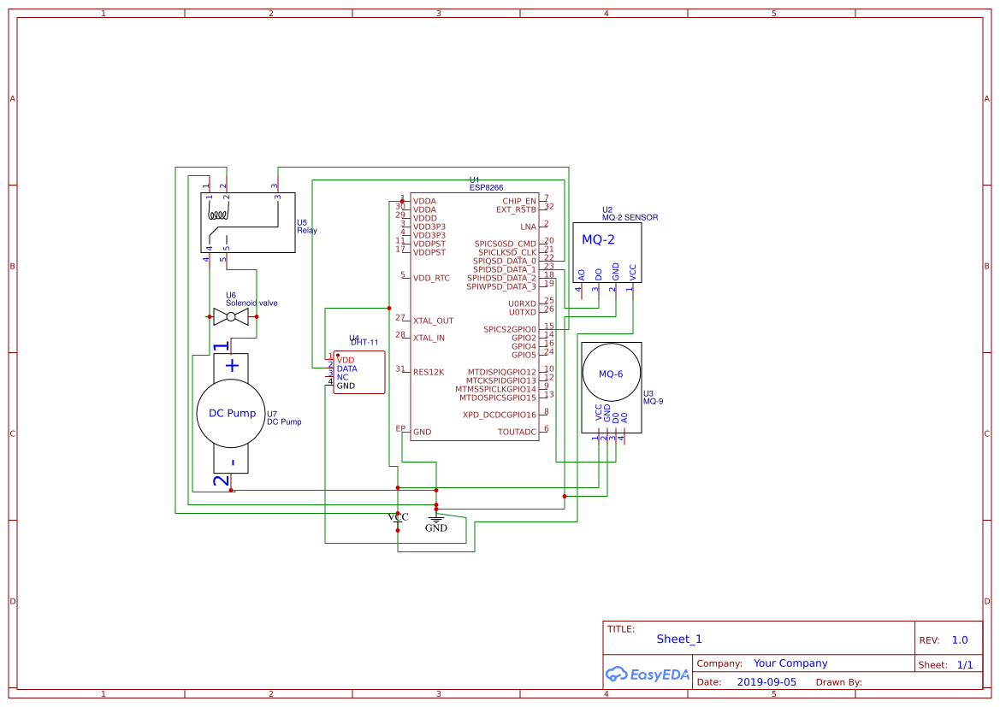
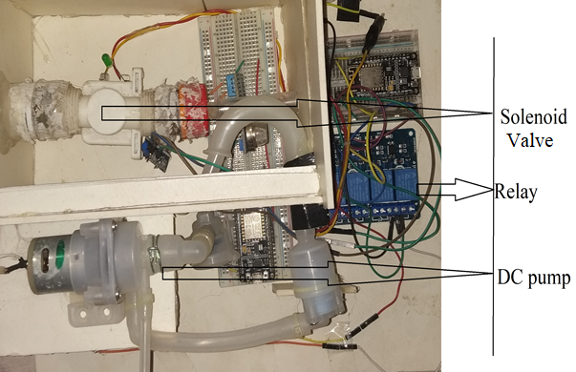
System Architecture
(a)
(b)
Fig. 2(a)Schematic diagram of the system (b)Implemented system
Environment Condition Monitoring and Long Distance Actuator Control using Wireless Sensor Network (WSN)
Date : 07.09.2019 MTE 4210 Page No. : 9

Slide 11
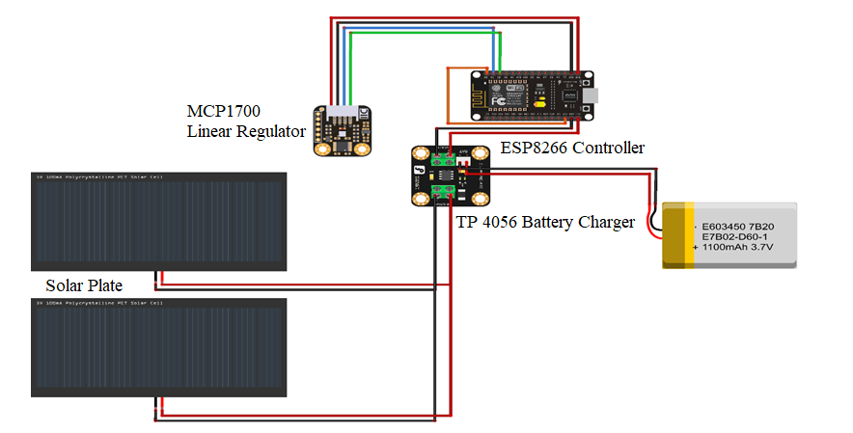
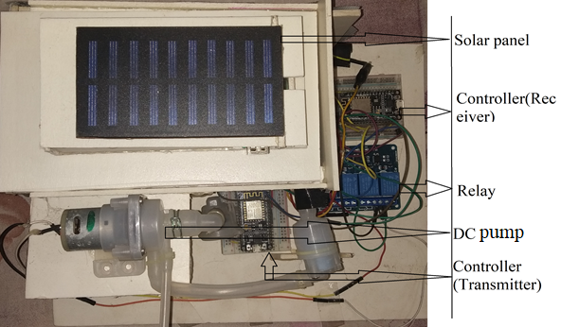
System Architecture (Renewable energy assisted power source)
Fig.3 : (a)Schematic diagram of solar system (b)Implemented system
Environment Condition Monitoring and Long Distance Actuator Control using Wireless Sensor Network (WSN)
Date : 07.09.2019 MTE 4210 Page No. : 10

Slide 12
System Overview
Data Acquisition
MQTT Server
Condition Monitoring
Controlling Actuator State
Fig. 4 (a): Block diagram of the system overview
Environment Condition Monitoring and Long Distance Actuator Control using Wireless Sensor Network (WSN)
Date : 07.09.2019 MTE 4210 Page No. : 11

Slide 13
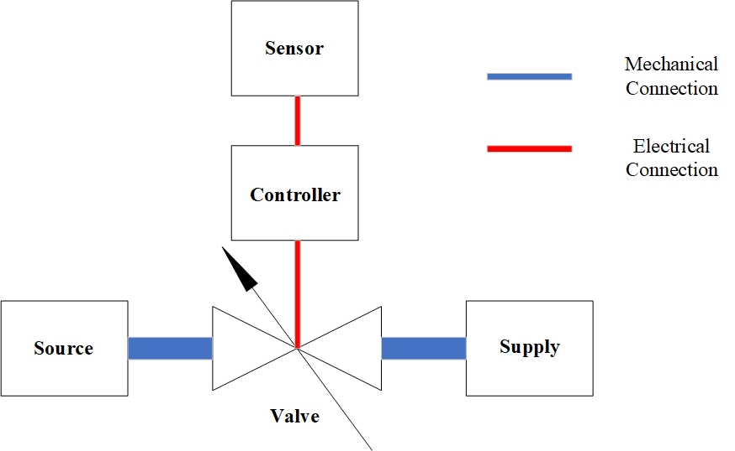
System Overview (Continued)
Fig.4(b): Control Diagram of the System
Environment Condition Monitoring and Long Distance Actuator Control using Wireless Sensor Network (WSN)
Date : 07.09.2019 MTE 4210 Page No. : 12

Slide 14
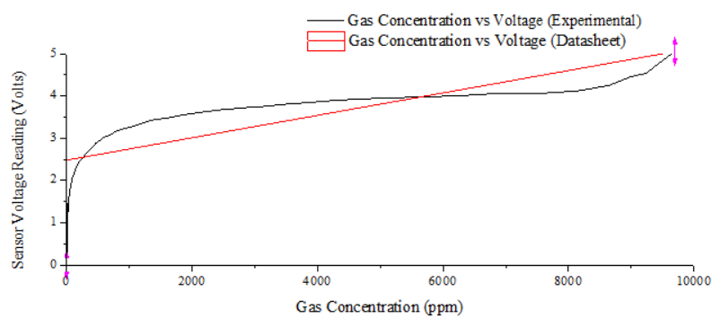
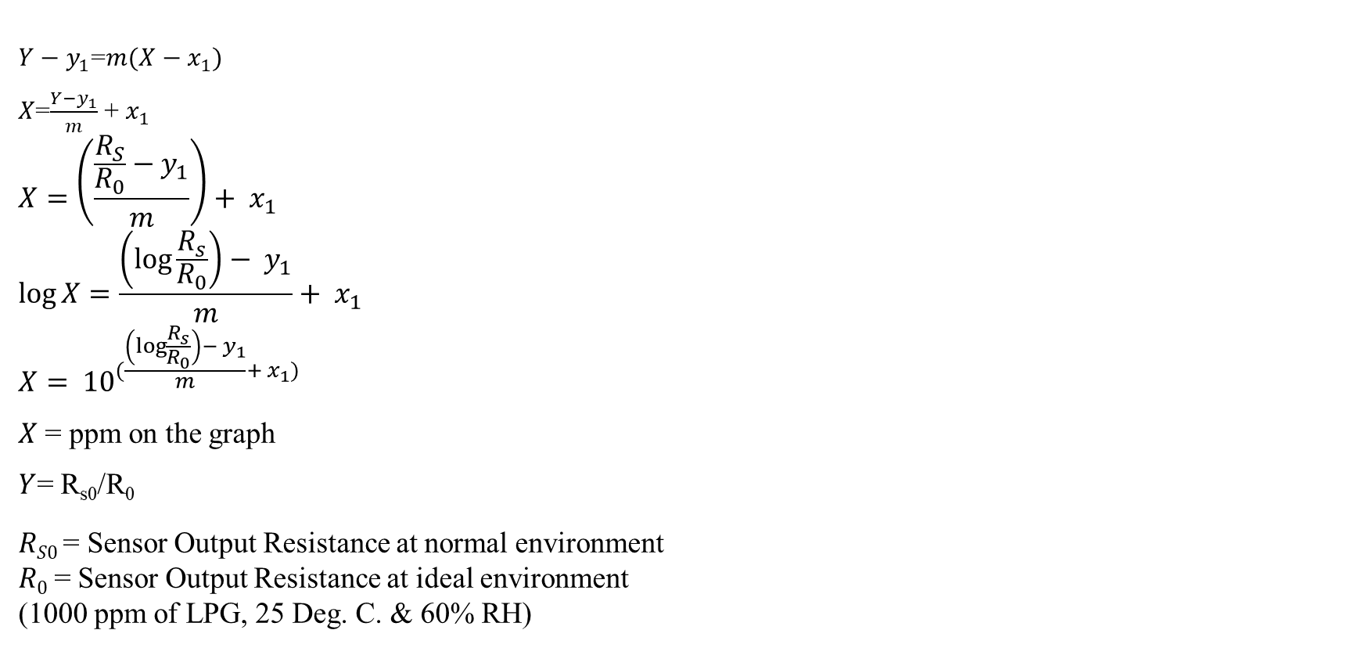
Sensor Data Calibration (ADC to PPM)
$Y−y_{1}$=$m(X−x_{1})$
$X$=$\frac{Y−y_{1}}{m}$ + $x_{1}$
$$X=\left(\frac{\frac{R_{S}}{R_{0}}−y_{1}}{m}\right)+ x_{1}$$
$$\log{X=\frac{\left(\log{\frac{R_{s}}{R_{0}}}\right)− y_{1}}{m}+ x_{1}}$$
$$X= {10}^{(\frac{\left(\log{\frac{R_{s}}{R_{0}}}\right)− y_{1}}{m}+ x_{1})}$$
$X$ = ppm on the graph
$Y$= R_{s0}/R₀
$RS0$ = Sensor Output Resistance at normal environment
$R0$= Sensor Output Resistance at ideal environment
(1000 ppm of LPG, 25 Deg. C. & 60% RH)
Fig.5: Voltage vs Gas Concentration(in PPM) plot (MQ-2 Gas Sensor)
Environment Condition Monitoring and Long Distance Actuator Control using Wireless Sensor Network (WSN)
Date : 07.09.2019 MTE 4210 Page No. : 13

Slide 15
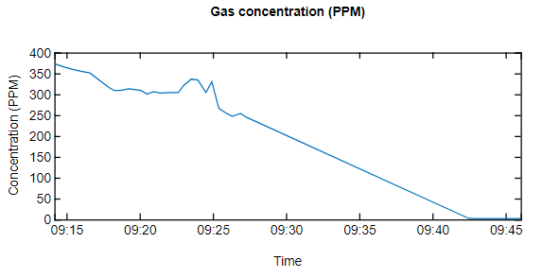
Sensor Data Acquisition and Analysis
(PM)
Fig.6: Gas Concentration (in PPM) with respect to time (MQ-2 Gas Senor)
Environment Condition Monitoring and Long Distance Actuator Control using Wireless Sensor Network (WSN)
Date : 07.09.2019 MTE 4210 Page No. : 14

Slide 16
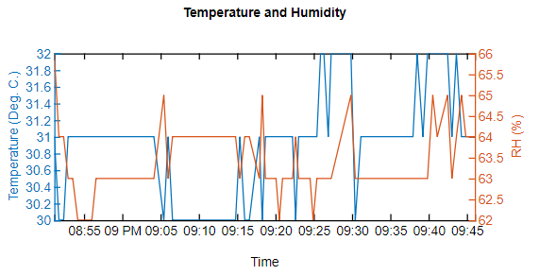
Sensor Data Acquisition and Analysis (Continued)
(PM)
Fig.7: Temperature and Relative Humidity with respect to time (DHT-11 Sensor)
Environment Condition Monitoring and Long Distance Actuator Control using Wireless Sensor Network (WSN)
Date : 07.09.2019 MTE 4210 Page No. : 15

Slide 17
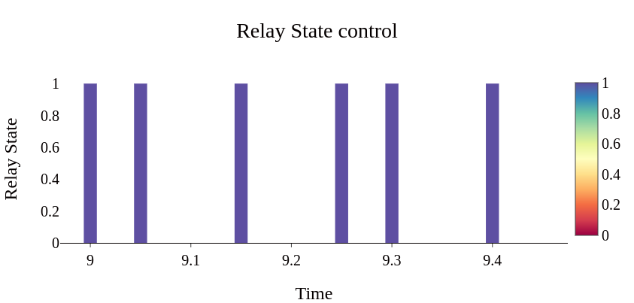
Sensor Data Acquisition and Analysis (Continued)
(PM)
Fig.8: Relay state ON/OFF using Feedforward control system (For Actuator Controlling)
Environment Condition Monitoring and Long Distance Actuator Control using Wireless Sensor Network (WSN)
Date : 07.09.2019 MTE 4210 Page No. : 16

Slide 18
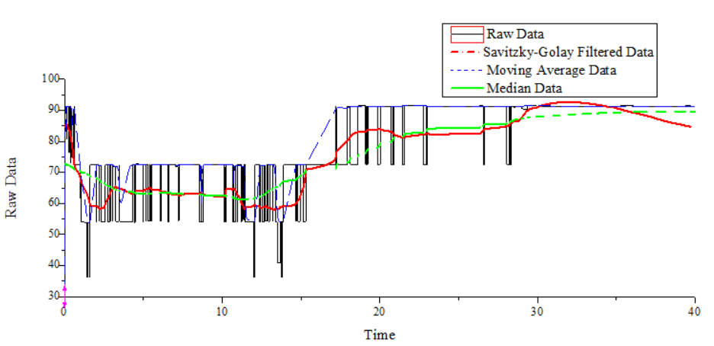
Sensor Data Acquisition and Analysis (Continued)
(ppm)
(sec)
Fig.9: Gas Concentration Signal Processing using Savitzky-Golay Filter, Moving Avg. Filter & Median Filter
Environment Condition Monitoring and Long Distance Actuator Control using Wireless Sensor Network (WSN)
Date : 07.09.2019 MTE 4210 Page No. : 17

Slide 19
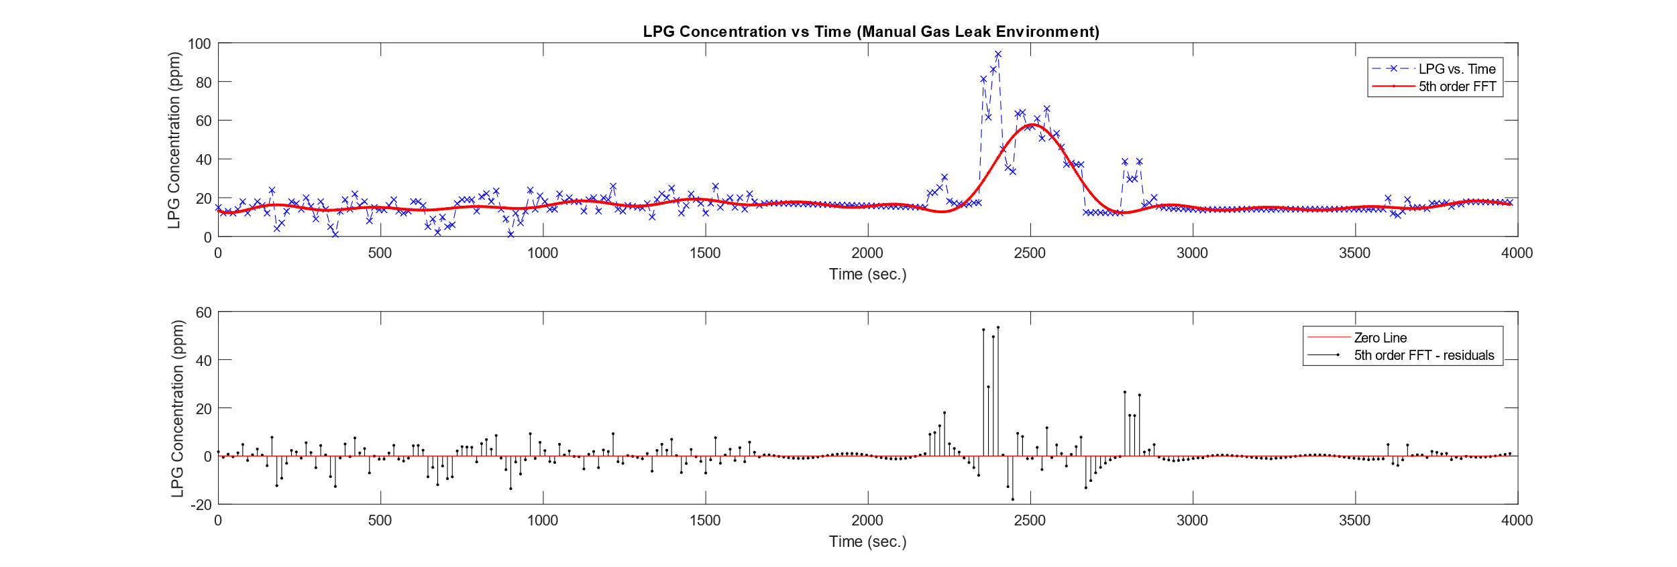
Sensor Data Acquisition and Analysis (Continued)
Fig.10: Processed Signal for LPG Concentration at manual leak environment
Environment Condition Monitoring and Long Distance Actuator Control using Wireless Sensor Network (WSN)
Date : 07.09.2019 MTE 4210 Page No. : 18

Slide 20
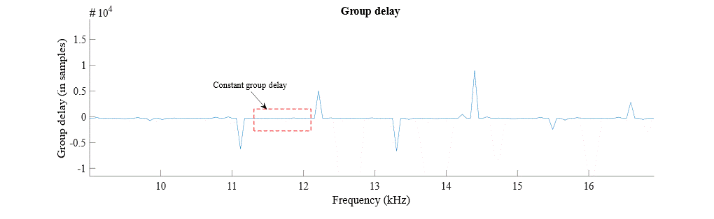
Sensor Data Acquisition and Analysis (Continued)
Fig.11: Group delay response plot for the gas sensor
Environment Condition Monitoring and Long Distance Actuator Control using Wireless Sensor Network (WSN)
Date : 07.09.2019 MTE 4210 Page No. : 19

Slide 21
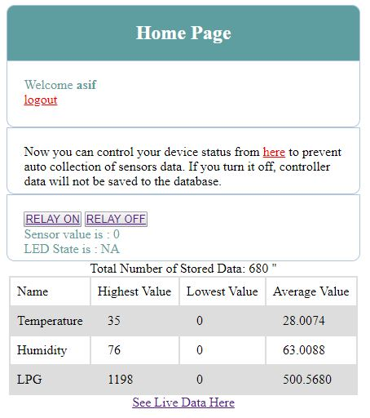
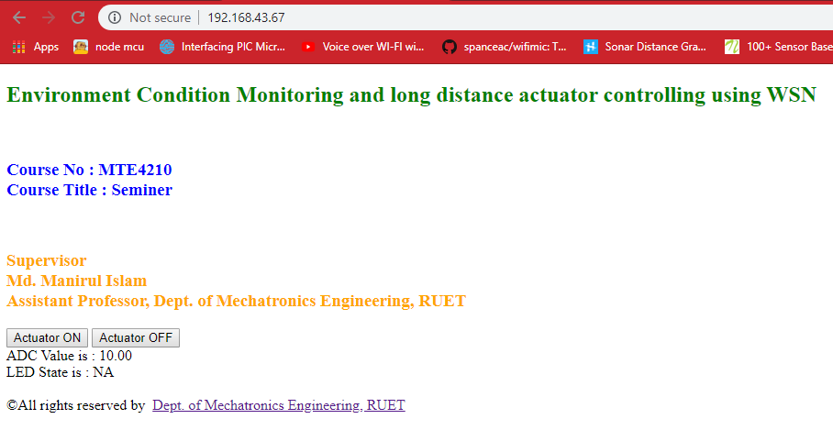
MQTT Server Design & Implementation
(a)
(b)
Fig.12 : (a) Server home Page (b) Actuator Control server
Environment Condition Monitoring and Long Distance Actuator Control using Wireless Sensor Network (WSN)
Date : 07.09.2019 MTE 4210 Page No. : 20

Slide 22
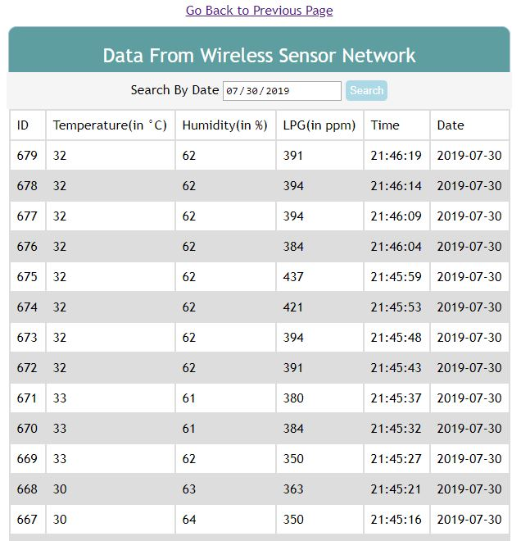
MQTT Server Design & Implementation
(Continued)
Fig.13 : Data Storing to Database from Sensors
Environment Condition Monitoring and Long Distance Actuator Control using Wireless Sensor Network (WSN)
Date : 07.09.2019 MTE 4210 Page No. : 21

Slide 23
Discussion
The fabricated system run successfully and more then 1000 trials were performed to measure it’s performance.
Some errors were observed during those 17 trials.
The system took less than 1 second to control the actuator with respect to given commands.
From analyzed signals the group delay period seemed quite perfect when the Baud Rate (Sampling Frequency) tuning ranges are from 11 to 12.6 kHz.
Environment Condition Monitoring and Long Distance Actuator Control using Wireless Sensor Network (WSN)
Date : 07.09.2019 MTE 4210 Page No. : 22

Slide 24
Future Works
Voice commands technology can be implemented for controlling Actuators.
Adaptive fuzzy logic can be implemented for automatic controlling of AC, water pump and other equipment’s. It can also be used to pre-detect the probability of the fire.
Environment Condition Monitoring and Long Distance Actuator Control using Wireless Sensor Network (WSN)
Date : 07.09.2019 MTE 4210 Page No. : 24

Slide 25
Conclusion
What we have done?
A low cost and easy operated system has been developed here which can be a good solution of monitoring environment and through this system proper response can be operated during hazards or any unwanted condition.
This system is capable to minimize the loss of any fire accident at any building and industry.
Environment Condition Monitoring and Long Distance Actuator Control using Wireless Sensor Network (WSN)
Date : 07.09.2019 MTE 4210 Page No. : 25

Slide 26

Video
Environment Condition Monitoring and Long Distance Actuator Control using Wireless Sensor Network (WSN)
Date : 07.09.2019 MTE 4210 Page No. : 25

Slide 27
Thank You

